Slide 1

Investors' Aggressiveness in Open Subscription and the Performance of Initial Public Offerings Chao-Shi Wang, Roger C. Y. Chen (2008)
107428023 謝逸昕
107428025 陸椀琳
107428011 許博惇

Slide 2

Abstract
Results
Data
Methodology
Introduction

Slide 3
Introduction

Slide 4
Introduction
This study investigates the relation between investors’ aggressiveness in open subscription and the performance of initial offerings.
This research also tries to unveil the key factors that dominate investors’ aggressiveness.

Slide 5
Introduction
The empirical results reveal that investors grasp higher initial returns of IPOs along with higher level of investors’ aggressiveness but have negative returns in the long run.
With lower level of investors’ aggressiveness, on the contrary, IPOs will have comparatively worse initial returns and better long-term returns than those with higher investors’ aggressiveness.
Additionally, this study identifies underwriting prices, market timing, listing markets, and industry groupings have significant influence on investors’ aggressiveness in open subscription of IPOs.

Slide 6
Methodology

Slide 7
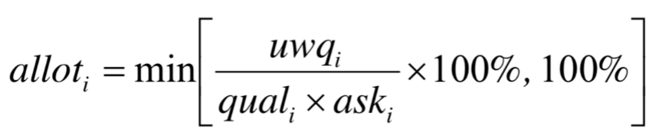
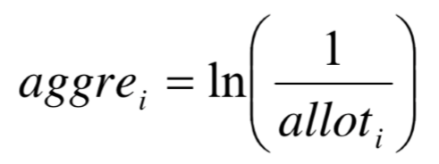
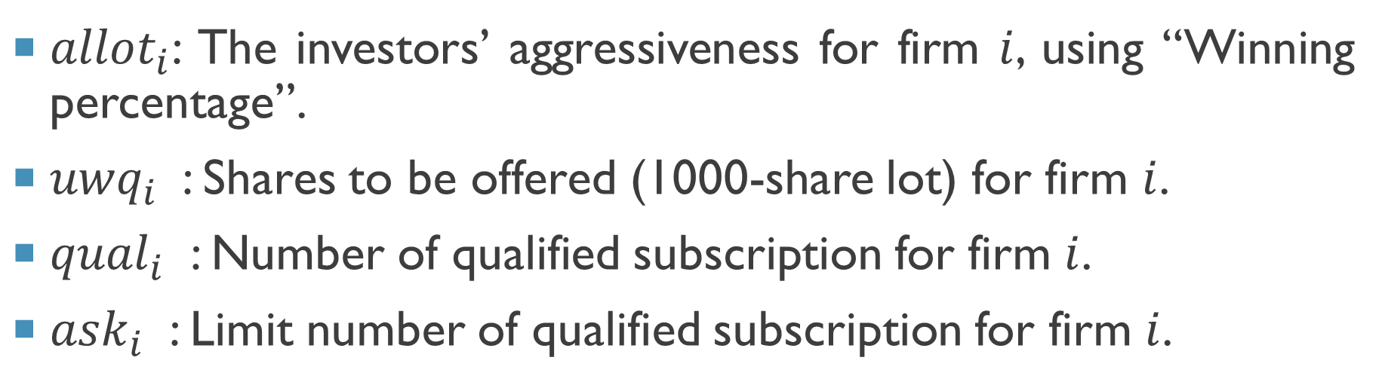
investors’ aggressiveness in open subscription OF IPOs
${allot}_{i}$: The investors’ aggressiveness for firm $i$, using “Winning percentage”.
${uwq}_{i}$ : Shares to be offered (1000-share lot) for firm $i$.
${qual}_{i}$ : Number of qualified subscription for firm $i$.
${ask}_{i}$ : Limit number of qualified subscription for firm $i$.
Notes:
https://www.twse.com.tw/en/page/announcement/publicForm.html

Slide 8
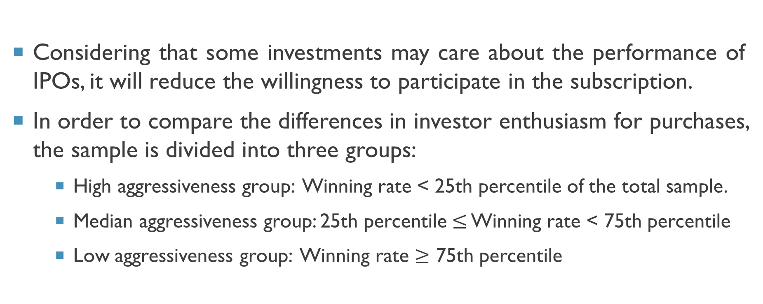
investors’ aggressiveness in open subscription OF IPOs
Considering that some investments may care about the performance of IPOs, it will reduce the willingness to participate in the subscription.
In order to compare the differences in investor enthusiasm for purchases, the sample is divided into three groups:
High aggressiveness group: Winning rate < 25th percentile of the total sample.
Median aggressiveness group: 25th percentile $≤$ Winning rate < 75th percentile
Low aggressiveness group: Winning rate $≥$ 75th percentile

Slide 9
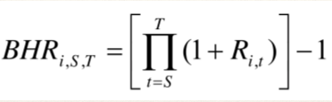
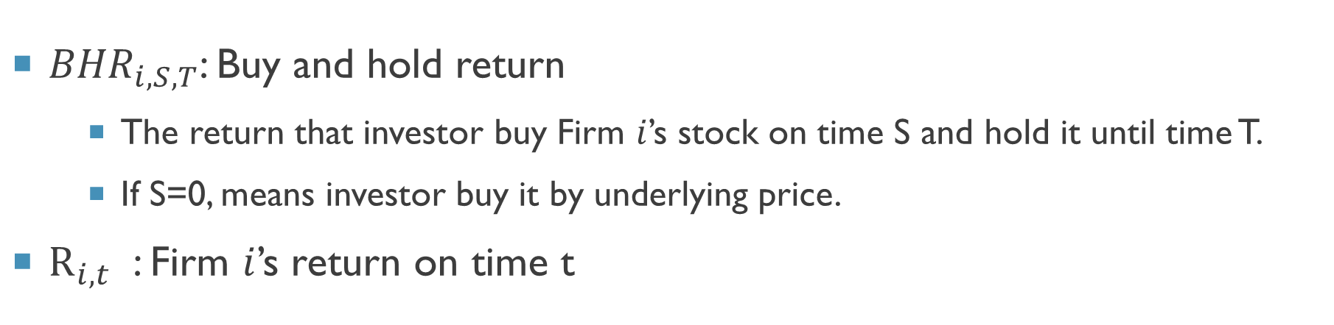
Performance OF IPOs ── Buy and hold return
${BHR}_{i,S,T}$: Buy and hold return
The return that investor buy Firm $i$’s stock on time S and hold it until time T.
If S=0, means investor buy it by underlying price.
$R_{i,t}$ : Firm $i$’s return on time t

Slide 10


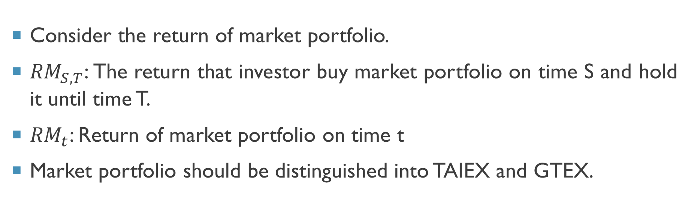
Performance OF IPOs ── accumulated Abnormal return
Consider the return of market portfolio.
${RM}_{S,T}$: The return that investor buy market portfolio on time S and hold it until time T.
${RM}_{t}$: Return of market portfolio on time t
Market portfolio should be distinguished into TAIEX and GTEX.

Slide 11
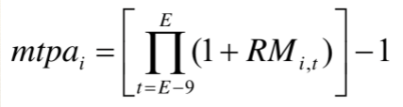
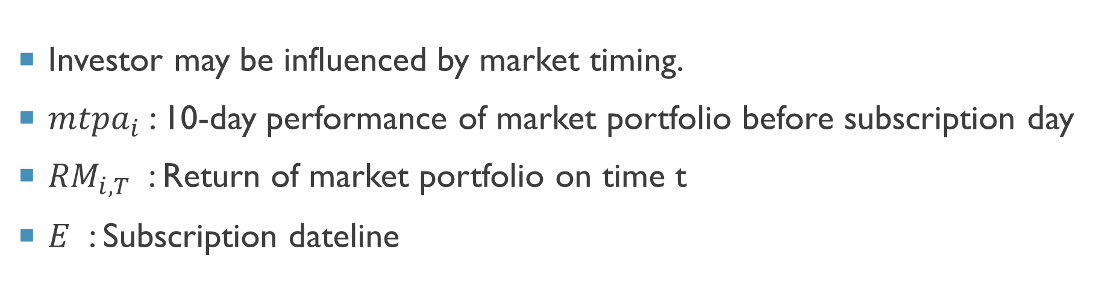
Market timing
Investor may be influenced by market timing.
${mtpa}_{i}$: 10-day performance of market portfolio before subscription day
${RM}_{i,T}$ : Return of market portfolio on time t
$E$ : Subscription dateline

Slide 12
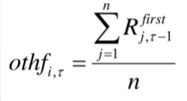
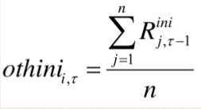
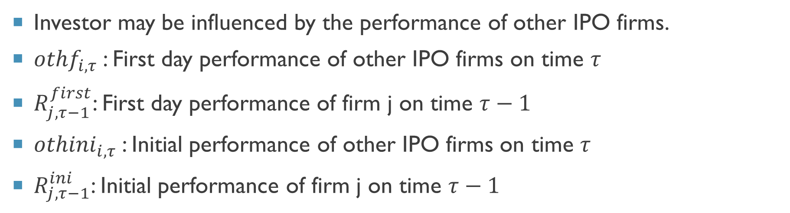
Market timing
Investor may be influenced by the performance of other IPO firms.
${othf}_{i,τ}$: First day performance of other IPO firms on time $τ$
$R_{j,τ−1}^{first}$: First day performance of firm j on time $τ−1$
${othini}_{i,τ}$: Initial performance of other IPO firms on time $τ$
$R_{j,τ−1}^{ini}$: Initial performance of firm j on time $τ−1$

Slide 13
DATA

Slide 14
DATA
Data: 2001/01~2006/12 IPOs firms.
Except:
(1) Over-the-counter (OTC) stock transferring to IPOs market
(2) Taiwan Depositary Receipt
(3) No trading data in IPO’s day and no data
Source: Taiwan Economic Journal (TEJ), Market Observation Post System (MOPS), Taiwan Stock Exchange Corporation (TWSE), Taiwan Securities Association

Slide 15
RESULTS

Slide 16
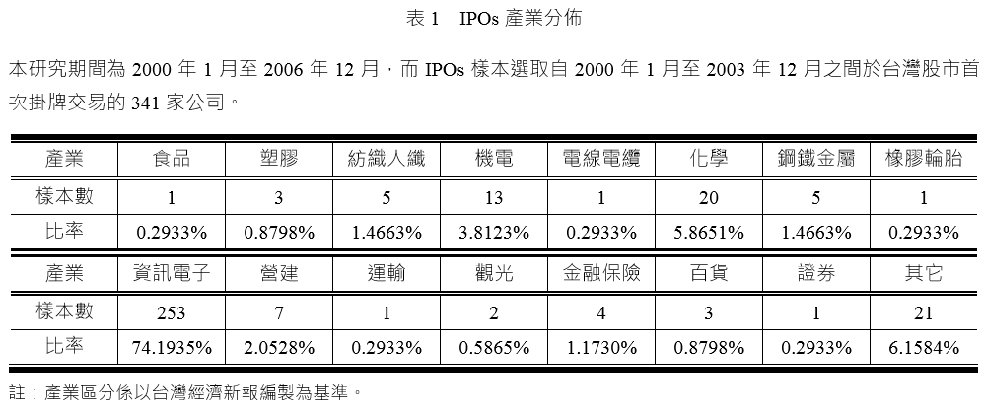
TABLE 1

Slide 17
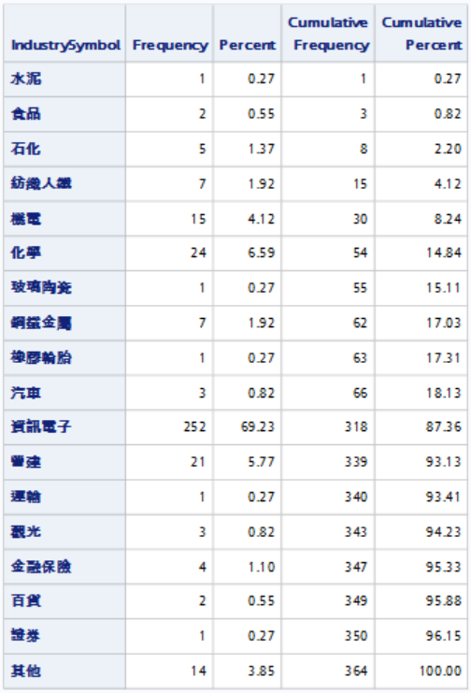

Slide 18
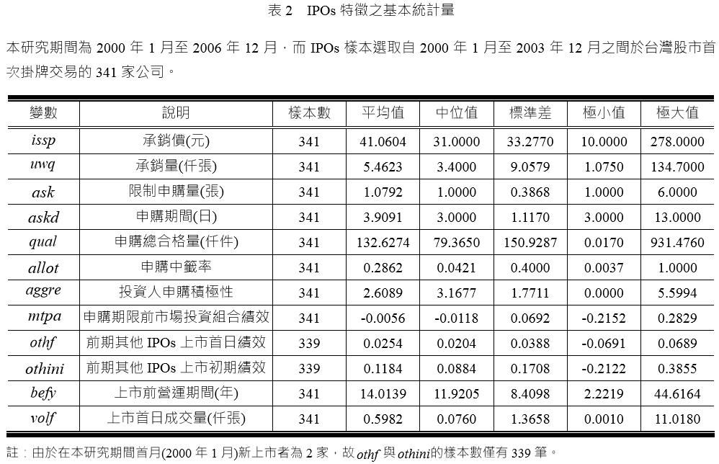
TABLE 2 ── Summary statistics

Slide 19
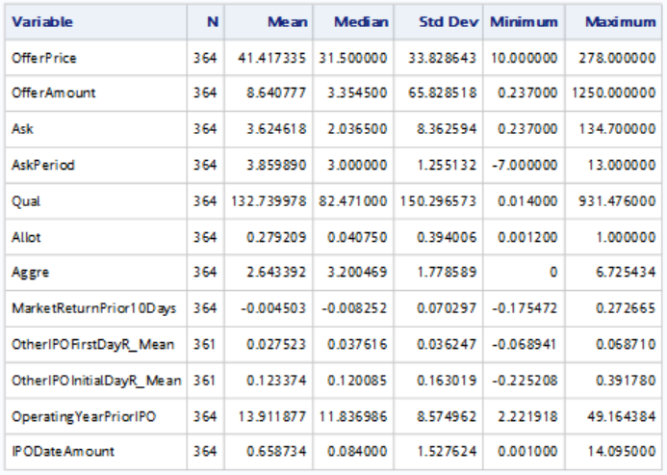

Slide 20
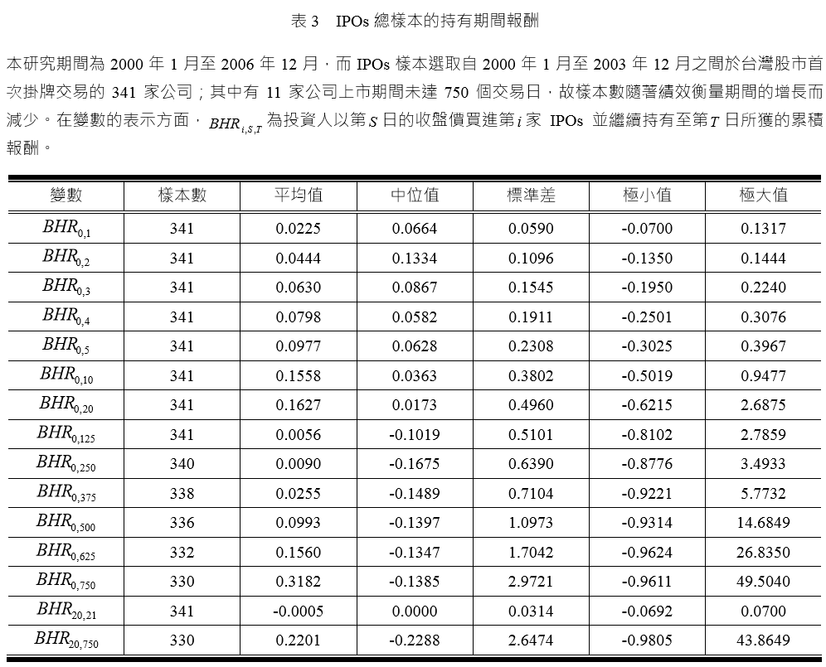
TABLE 3 ── Buy and hold return

Slide 21
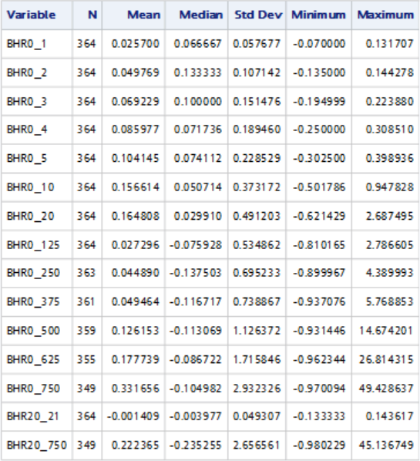

Slide 22
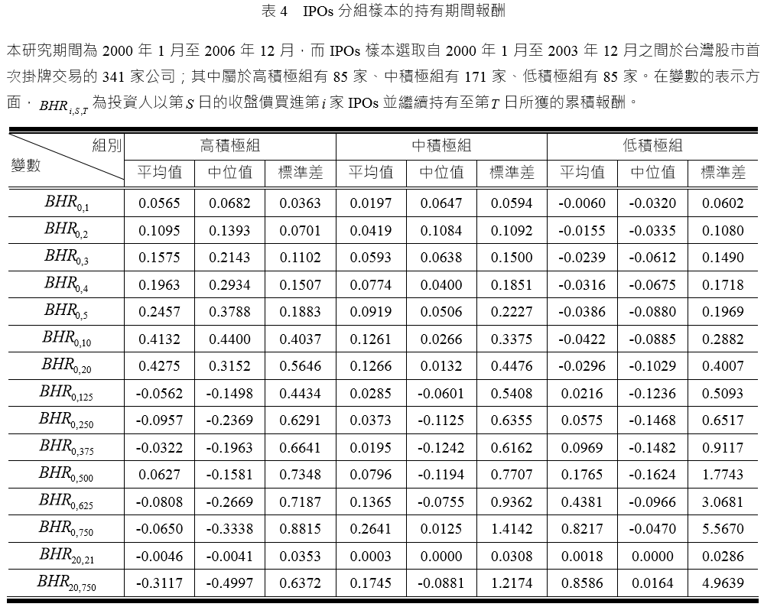
TABLE 4 ── Bhr in different group

Slide 23
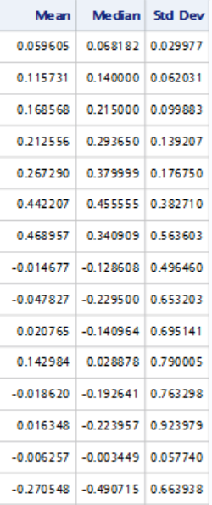
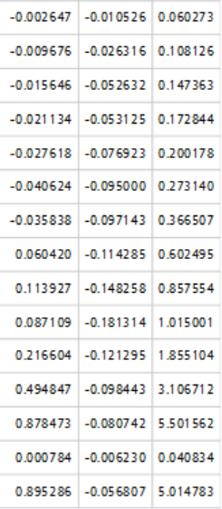

Slide 24
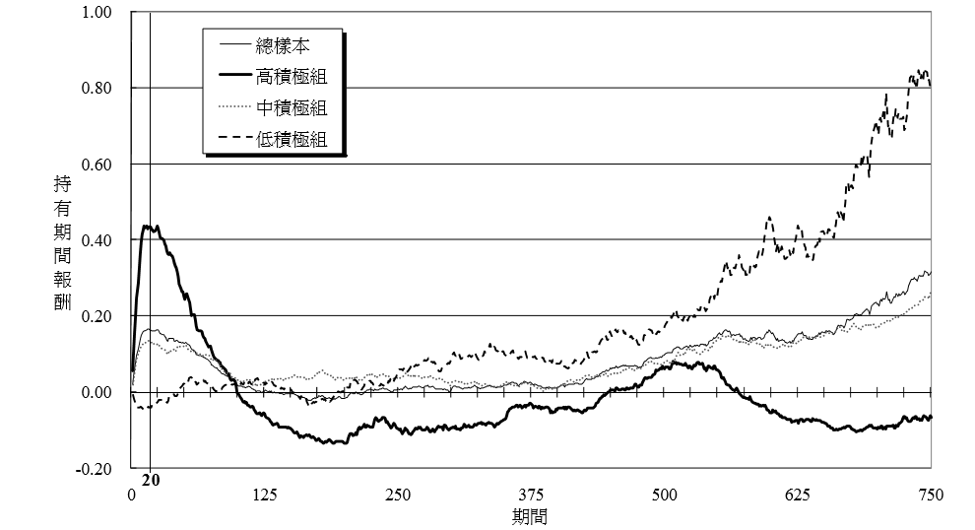
Figure 1 ── Trend of Bhr

Slide 25
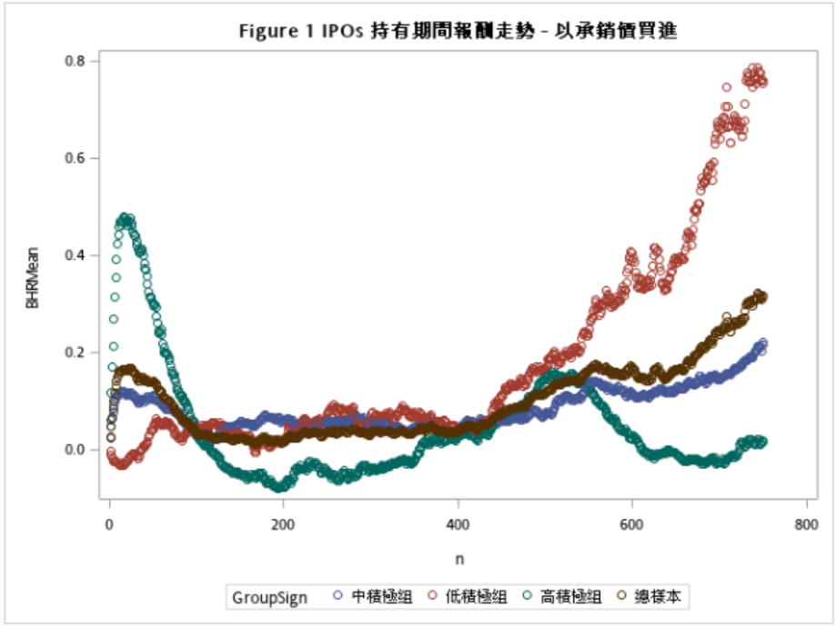

Slide 26
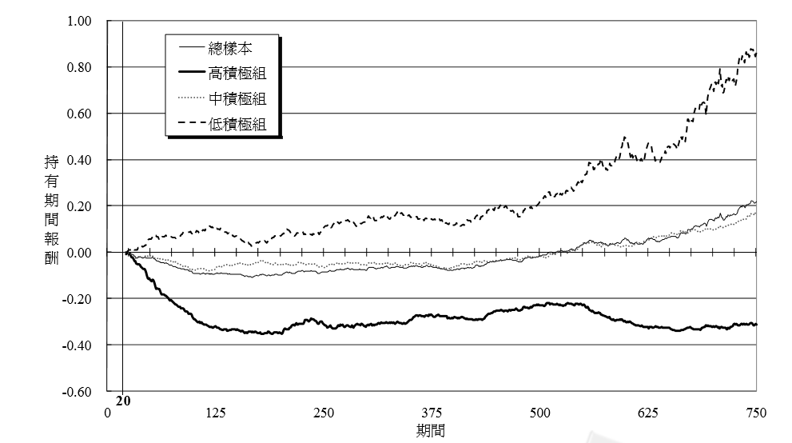
Figure 2

Slide 27
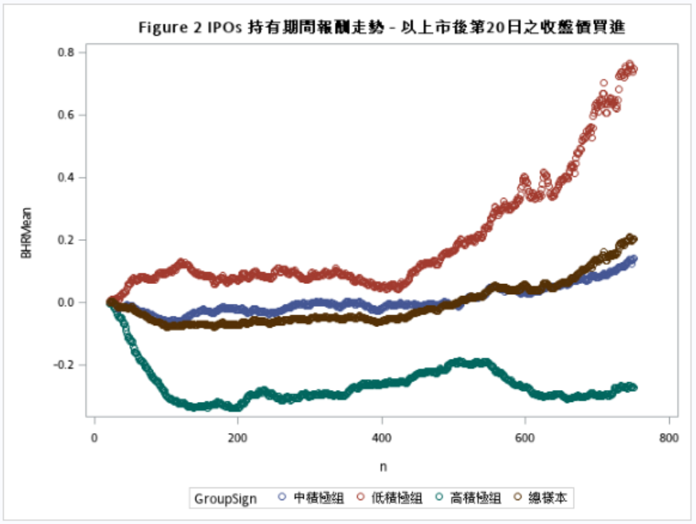

Slide 28
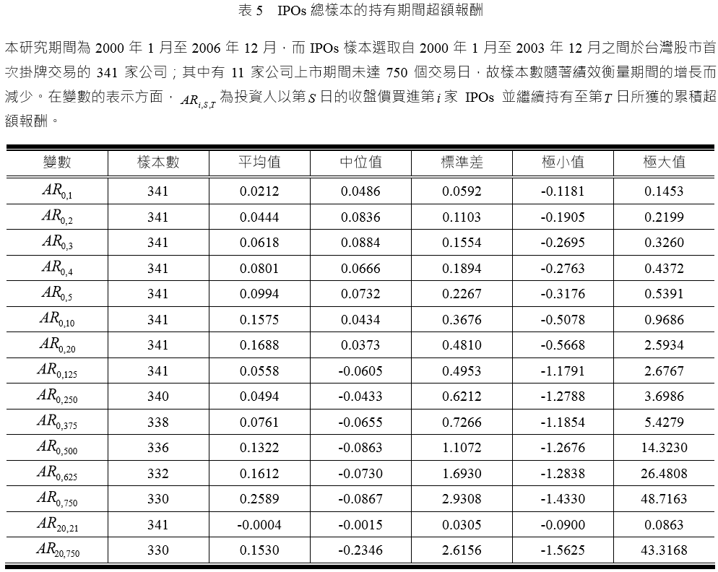
TABLE 5 ── abnormal return

Slide 29
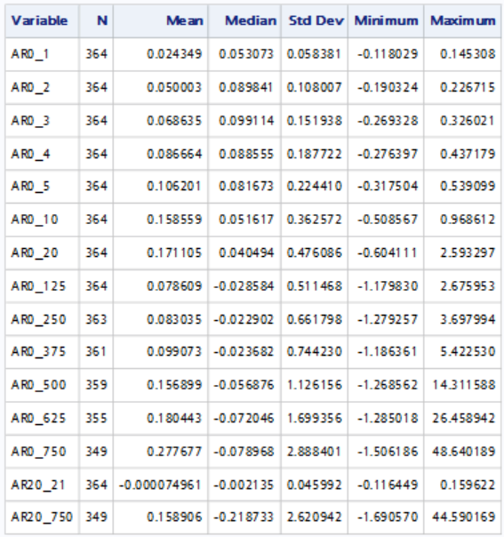

Slide 30
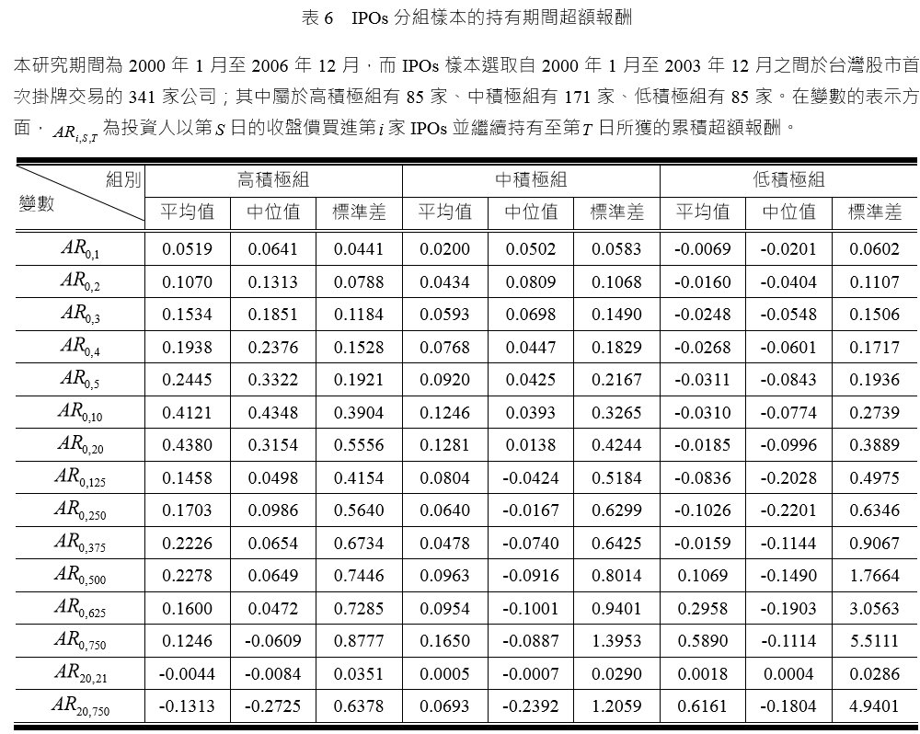
TABLE 6 ── ar in different group

Slide 31
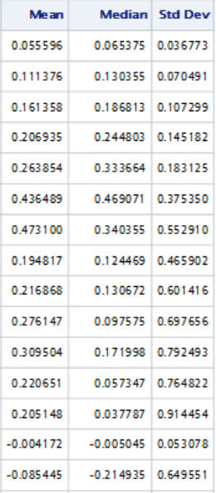
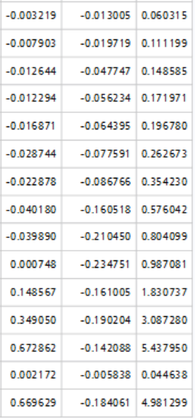

Slide 32
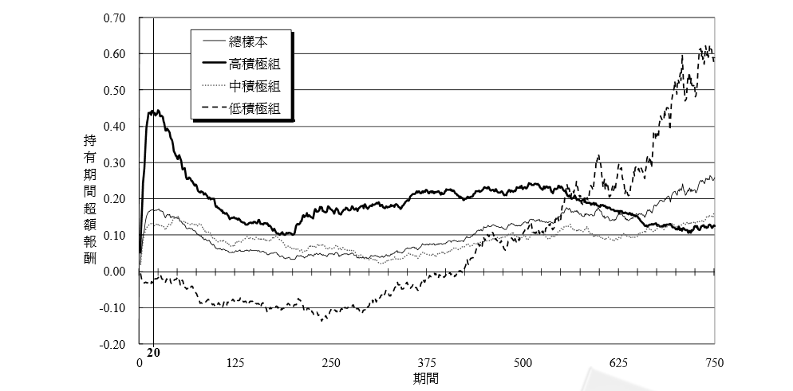
Figure 3

Slide 33
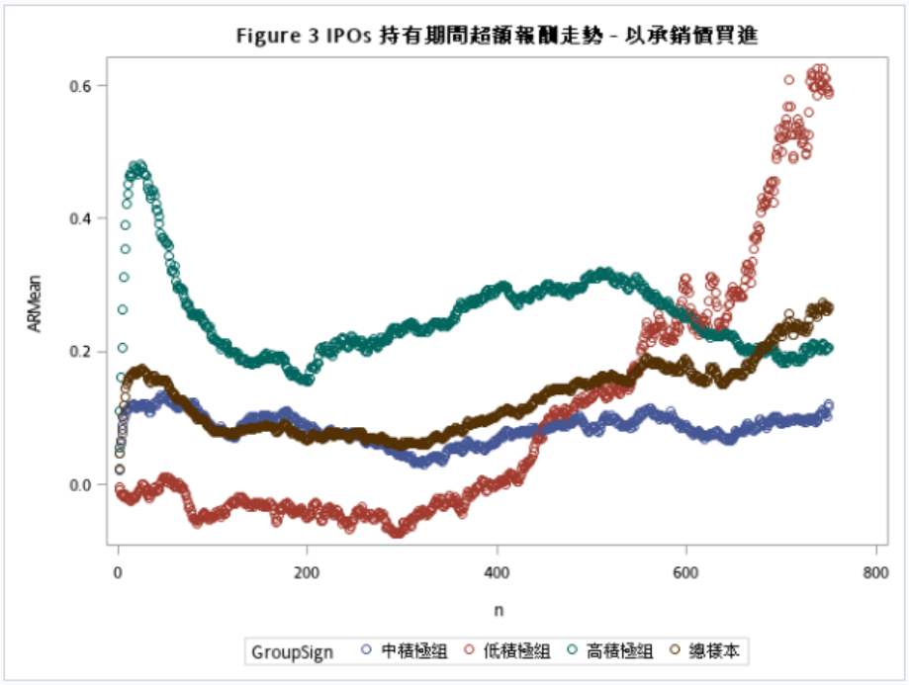

Slide 34
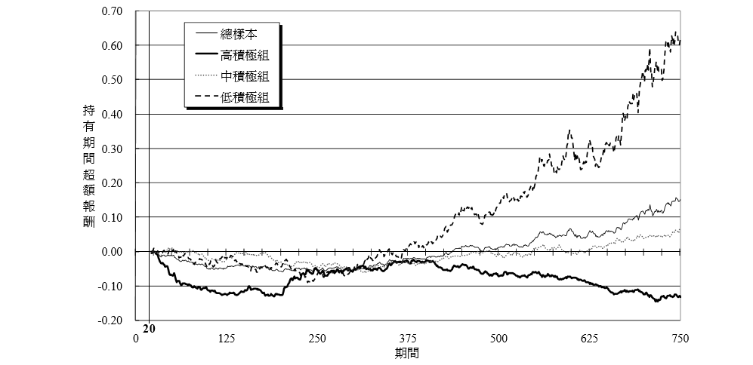
Figure 4

Slide 35
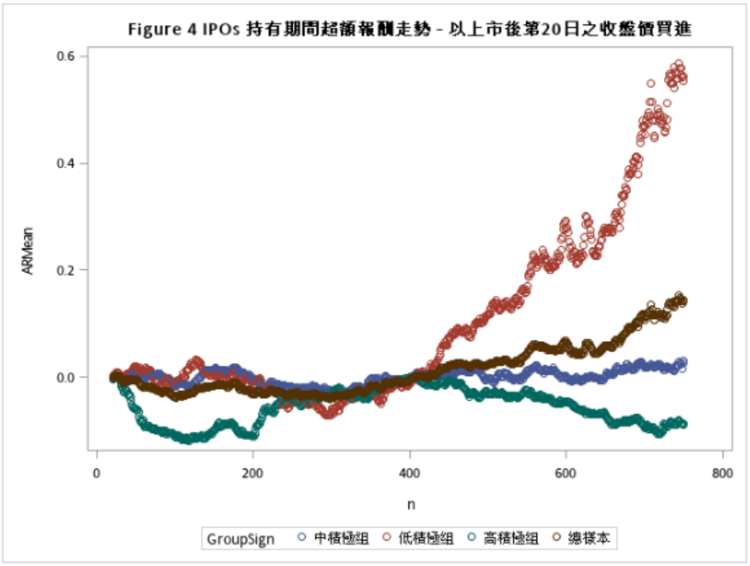

Slide 36
The relationship between the performance of IPO and investors’ aggressiveness

Slide 37

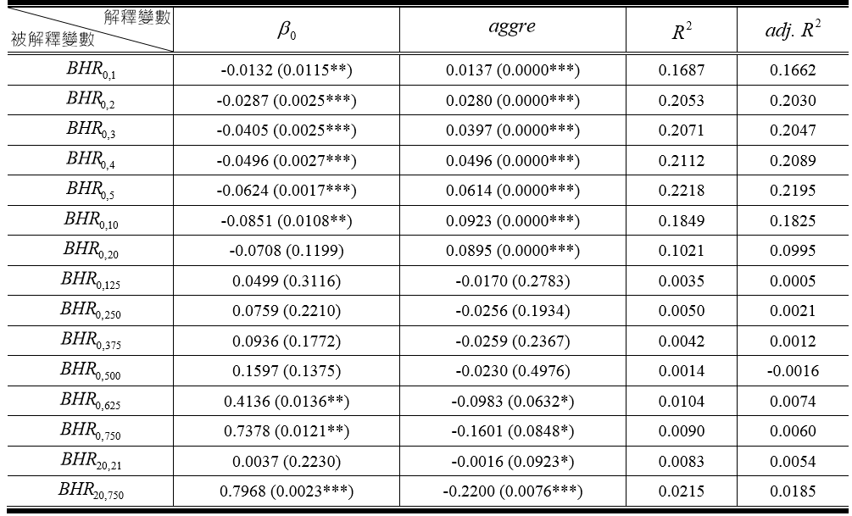
TABLE 7

Slide 38
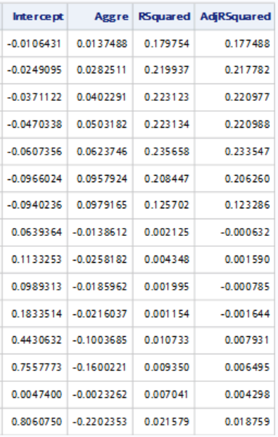

Slide 39

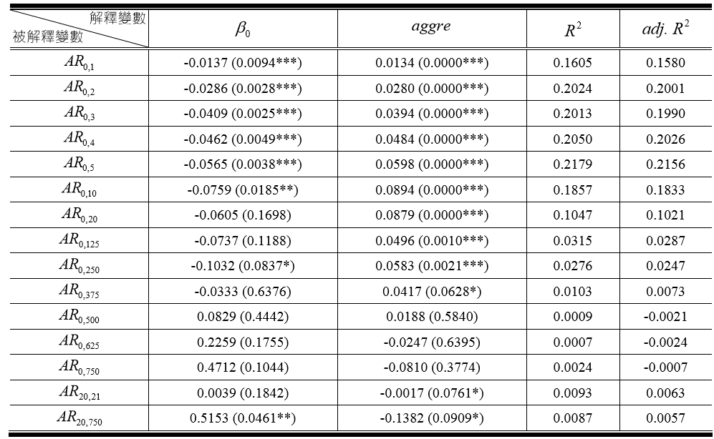
TABLE 8

Slide 40
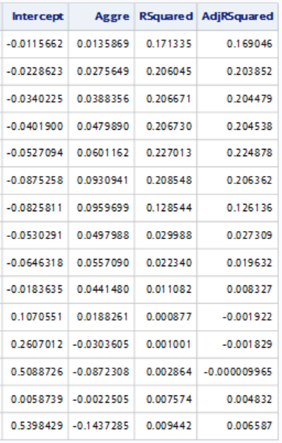

Slide 41
The relationship between investors’ aggressiveness and IPO characteristics

Slide 42

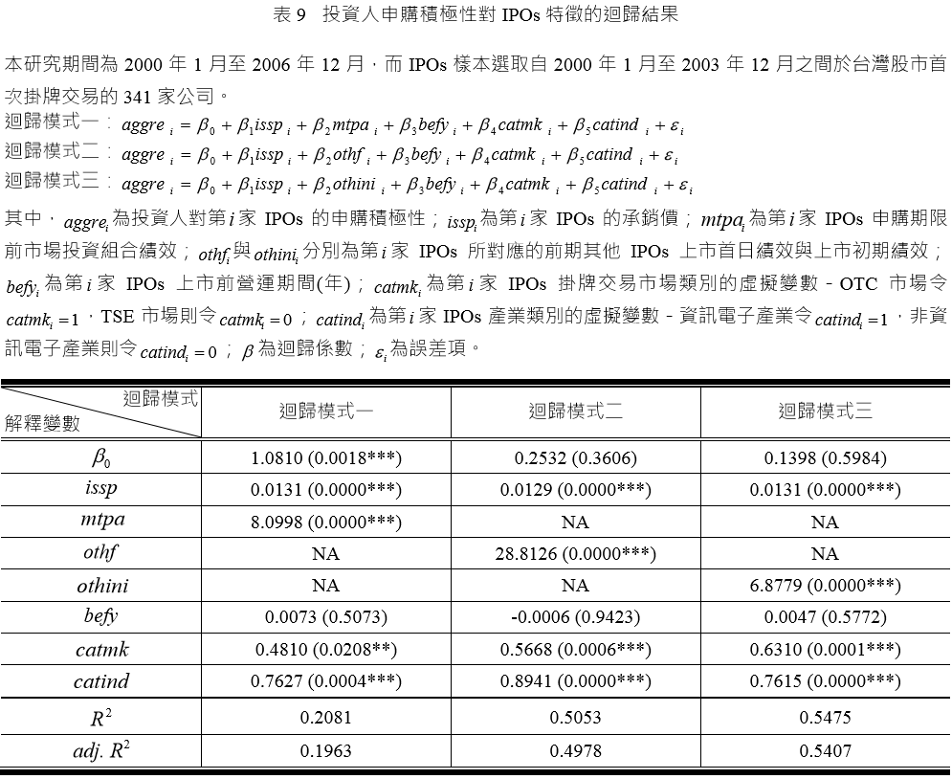
TABLE 9

Slide 43
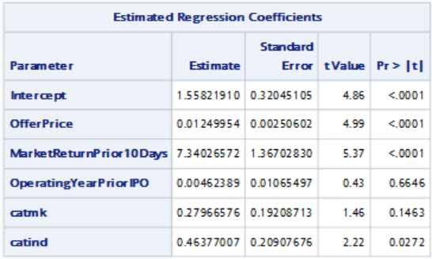


Slide 44
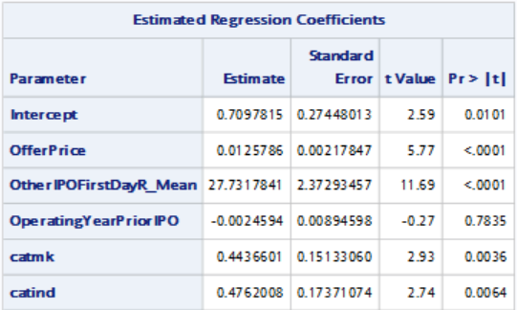


Slide 45
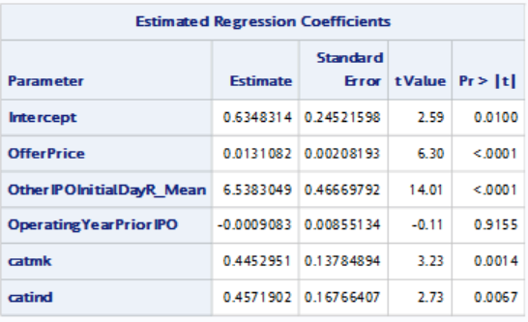


Slide 55
Something Interesting

Slide 56
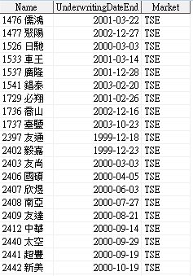
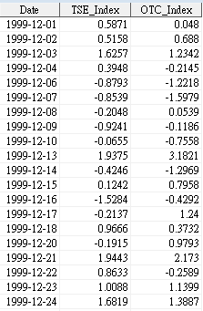
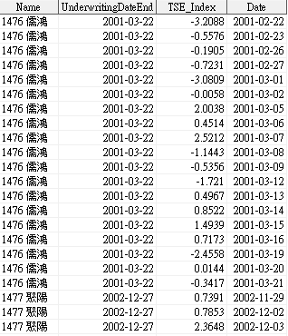
Market Timing
proc sql;
create table TSE_Market
as select a.Name, a.UnderwritingDateEnd, b.TSE_Index, b.date
from TSE a left join MarketIndexReturn b
on intnx(‘weekday’,b.date,1) <= a.UnderwritingDateEnd <= intnx('weekday',b.date,20)
order by a.Name, b.date;
quit;

Slide 57
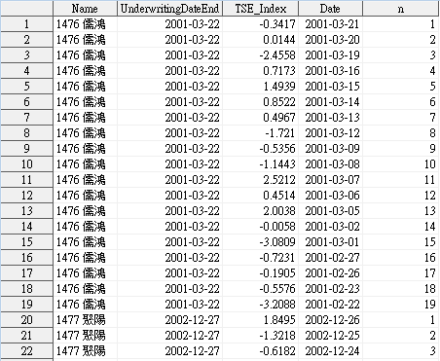
Market Timing
proc sort data = TSE_Market;
by Name descending Date;
run;
data TSE_Market_Count;
set TSE_Market;
by Name descending Date;
retain n 0;
n=n+1;
if first.Name then n=1;
run;

Slide 58
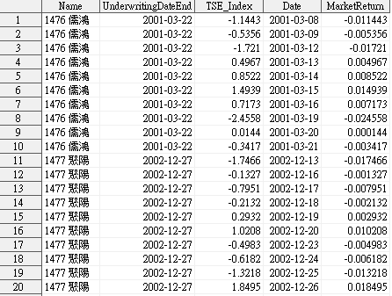
Market Timing
proc sql;
create table TSE_Market_Final (drop=n)
as select *, TSE_Index/100 as MarketReturn
from TSE_Market_Count
where 1<=n<=10
order by Name, n;
quit;

Slide 59
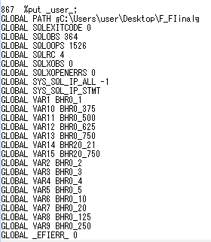
Do loop to build fifteen regressions
data SetBHRSign;
input var $ text $9.;
call symput(var,text);
cards;
VAR1 BHR0_1
VAR2 BHR0_2
VAR3 BHR0_3
. .
. .
VAR13 BHR0_750
VAR14 BHR20_21
VAR15 BHR20_750
;
run;
%put _user_;

Slide 60
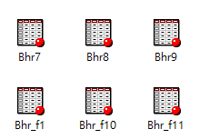
Do loop to build fifteen regressions
%macro RegAggreToBHR(x,var);
title "&&var&x";
proc surveyreg data=FinalData;
model &&var&x = Aggre:/adjrsq;
ods output ParameterEstimates=BHR&x FitStatistics=BHR_F&x;
run;
%mend;
%macro loop;
%do x=1 %to 15;
%RegAggreToBHR(&x);
%end;
%mend;
%loop

Slide 61
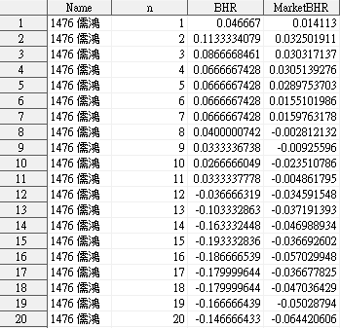
BHR
proc sort data = Firm_MarketReturnWithNumber;
by Name Date n;
run;
data CalculateFirm_MarketBHR;
set Firm_MarketReturnWithNumber;
by Name;
retain BHR_NeedMinus1 MarketBHR_NeedMinus1;
if first.Name then do;
BHR_NeedMinus1 = (1 + Return);
MarketBHR_NeedMinus1 = (1 + MarketReturn);
end;
else do ;
BHR_NeedMinus1 = BHR_NeedMinus1 * (1+Return);
MarketBHR_NeedMinus1 = MarketBHR_NeedMinus1*(1 + MarketReturn);
end;
BHR = BHR_NeedMinus1 -1;
MarketBHR = MarketBHR_NeedMinus1 - 1;
drop BHR_NeedMinus1 MarketBHR_NeedMinus1;
keep Name n BHR MarketBHR;
run;

Slide 62


Proc transpose
proc transpose data = FirmBHRForEachPeriod
out = TransposeFirmBHRForEachPeriod
prefix = n;
var BHR;
by Name;
run;

Slide 63



Proc format
proc format;
value AggreFormat
LOW - 0.01620 = "高積極組"
0.01620 -< 0.43875 = "中積極組"
0.43875 - HIGH = "低積極組";
Data DataForTable4;
set FinalData;
keep Name Allot BHR: ;
format Allot AggreFormat.;
run;

Slide 64

Proc sgplot
proc sgplot data = DataForFigure1;
scatter x=n y=BHRMean / group=GroupSign;
title "Figure 1 IPOs 持有期間報酬走勢 - 以承銷價買進";
run;

Slide 65
Thanks for listening

